Slide 1
Webpage based iot home automation
By
P . B Varshith ( T L)
P. Shahid Khan
Praneeth Challa
B. V. Harshatheeswar Reddy

Slide 2
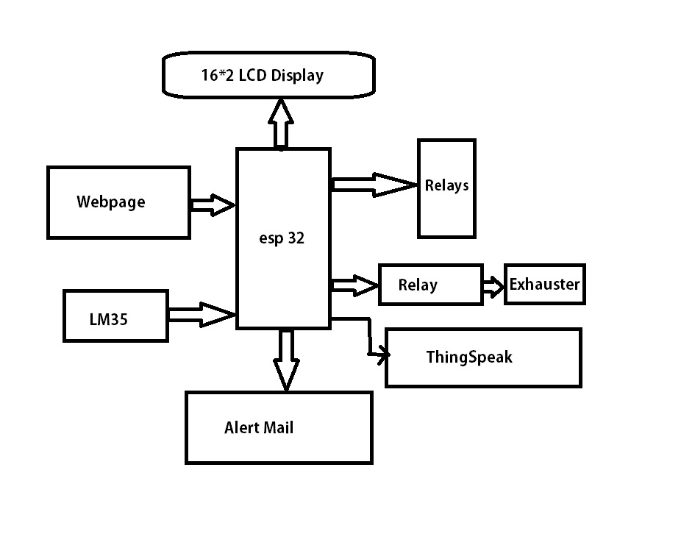
Block Diagram

Slide 3
Components
ESP32
LM35
Relay Modules
LCD Display
DC Motor
Bread Board

Slide 4
Description
In the previous block diagram , the inputs are taken from the webpage that we created and the temperature information is taken from the LM35 to ESP32 Microcontroller .
The output is given to respective Relay Modules which are connected by external devices like Lights , fans etc.
And an LCD is provided to mention which relay is switched ON .

Slide 5
Firstly , we have to create webpage with 4 buttons to control the Relay Modules.
We have to write the code in such a way that the readings from the LM35 should be visible on the webpage.
By using this type of algorithm and technology we can control any device from any part of the world just by accessing the IP address generated by the microcontroller.

Slide 6
Applications
To control home automation systems including 1. lighting
2. heating (such as thermostats)
3.ventilation
4. air conditioning and security

Slide 7
ThankYou

